Slide 1
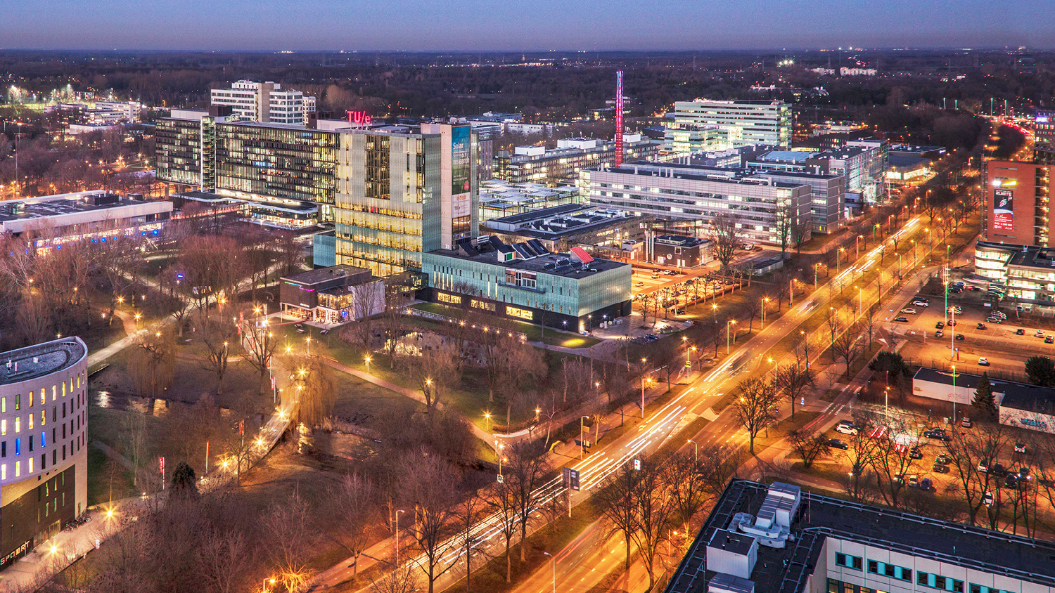
Stakeholder Analysis, Concerns and Functional Decomposition
Tuesday, 22 February 2022
Guilherme, Project Manager, PDEng Trainee MSD 2022
Anup, Software Architect, PDEng Trainee MSD 2022
1
2o21 MSD AutoRef Project

Slide 2
AGENDA
Project progress
Team division and current tasks
Functional decomposition
Questions from the team
2o21 MSD AutoRef Project

Slide 3

AutoRef - Progress
 | Week
Project activities schedule | 1 | 2 | 3 | 4 | 5 | 6
 | 10/02-17/02 | 17/02-24/02 | 24/02-03/03 | 03/03-10/03 | 10/03-17/03 | 17/03-24/03
Project Management Plan creation
2020 MSD project documents review
Hardware and software options evaluation
Project scope definition
New requirements creation
System architecture definition
Software creation
Software integration
Systems test
Real robot soccer match simulation
Documentations and main deliverables finished
2o21 MSD AutoRef Project

Slide 4
AutoRef - Progress
Systems
Implementation
Guilherme
Meghna
Anup
Yuri
Cevahir
Shubo
Kian
Marzhan
Feasibility
PMP – On going (80%) – 1st Draft sent to Harold
Use static cameras in the lab – On going
2020 MSD Project review (80%) – Rules implemented, code and simulation reviewed.
Use the turtles and its capabilities – On going
Project Scope definition (60%) – Stakeholders concerns, Systems decomposition, Starting requirements
Use of drones – On going
Use virtual simulation – On going
2o21 MSD AutoRef Project

Slide 5
Project Scope
Criteria | Virtual Simulation | Robot as referee | Drones | Static cameras
Pros | Easier to implement |  | Hardware partly available | Hardware already installed
 | Use most of the past year’s work |  | Achieve learning goals from all members | Use most of the past year’s work
 | Implement new cameras to simulate real field of Tech United |  |  | Can assist Human Referee for most of the rules
Cons | Do not achieve learning goals from all members | Do not use the implementation part from last year’s project, just the system part | Hard to control | Hard to be configured
 | Cannot assist Human Referee in a real match | Need to understand how to use RT DB | Still needs a camera | High image storage
 | Do not achieve the stakeholders’ goal
2o21 MSD AutoRef Project

Slide 6
Stakeholder and Proiritization
Erjen
Design Team(us)
6
2o21 MSD AutoRef Project

Slide 7
Erjen’s Prioritized Concerns
5 mins match 2 vs 2
Positive feedback from human referee
Log and show evidence for violation for rule violations
Build on previous work
Structured Software delivery
Documentation
Individual learning goals
2o21 MSD AutoRef Project

Slide 8
René’s Prioritized concerns
5 mins match 2 vs 2
Positive feedback from human referee
Log and show evidence for violation for rule violations
2o21 MSD AutoRef Project

Slide 9
Human Referee’s Prioritized concerns
Loose his/ her job.
To be assisted in rules that are difficult to interpret
Log and show evidence for violation for rule violations
Communication with AutoRef.
2o21 MSD AutoRef Project

Slide 10
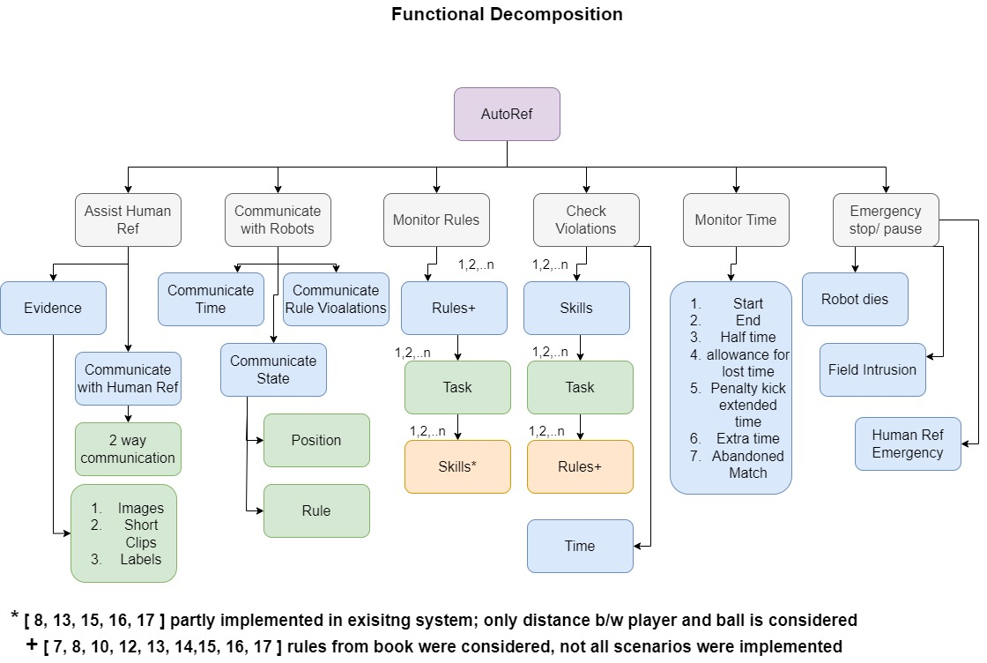

Slide 11
Questions:
How do referees judge the game? Is he observing from a certain position? Outside of the field?
What rules are difficult to be interpreted?
Does the referee receive any information from the robot?
What rules will be violated in the game?
What happens during conflicting situations? Does the referee pause the game and go to the field to check if the rule was really violated (for example if the ball fully crossed the line or distance between robots was really below the allowed threshold)?
How do the robots calculate where to pitch the ball and where the ball should land?
What means the word autonomous in the context?
When it will be the mid project presentation?
2o21 MSD AutoRef Project

